Slide 1
A Software Development project by Deep Pimpale as a part of Internship program by Exposys Data Labs.

Slide 2


Slide 3
Project Title Language Translator

Slide 4
Introduction
Language Translator is a web application to translate from English language to any other language you wish to translate and vice versa. It provides categories of commonly used words, sentences and phrases. As such, tourists can rely on mobile phone for communication purposes. This application will have the functionality of pronouncing the words, sentences and phrases.
This application is anticipated to overcome the language barrier among tourists, who are visiting various different countries. Subsequently, by using this application they are able to integrate with the local people and get the right information. There are many different hardware components found in mobile devices so their applications are developed using different software architectures. It is made more complicated because users of mobile applications have diverse preferences, so extensive improvements to traditional system development methodologies are required in order to keep up with this demand.

Slide 5
Aim and Objectives
Aim: To create a language translator web application that can translate from English to any language.
Objectives: The objective of this project is to create such a web application where users can translate text into English to any other Language and vice versa and to end the issues of Language barrier faced by people around the world.

Slide 6
Proposed Solution
The proposed solution of this project is to create a Language Translator Web application using jQuery and PHP without any API
jQuery is a JavaScript library, so it operates on top of JavaScript. It cannot exist on its own, so you can't use one over the other. You can use just JavaScript or JavaScript and jQuery. jQuery was introduced to make development with JavaScript easier. It will reduce the development time. Use it to add animation and even handling on your website.
jQuery simplifies HTML document traversing, event handling, animating, and Ajax interactions for rapid web development. jQuery is easier to use compared to JavaScript and its other JavaScript libraries. You need to write fewer lines of code while using jQuery, in comparison with JavaScript.
The name PHP stands for Hypertext Pre-processor and denotes a server-side scripting language, which suggests that applications written thereon run on web servers and don’t depend upon the online browser. Syntax of PHP language is analogous to C language. It is created by Rasmus Lerdorf and it appeared in 1995. PHP is being widely utilized in developing web applications and become one among main languages for developers to make new applications.
PHP is getting used widely in developing web-based and other applications across all domains. for a few of technology supported which PHP applications are developed listed below :
Content Management System.
Web-based applications and development of sites.
E-commerce websites and applications.
Data Analytics and Representation.
Processing of Images.
Graphical interface design based applications.

Slide 7
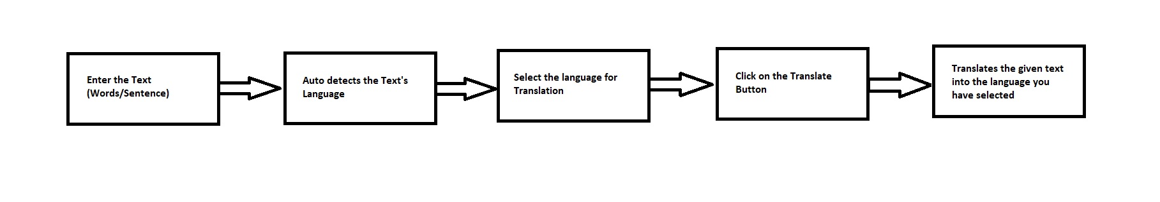
Architecture/Work Flow

Slide 8
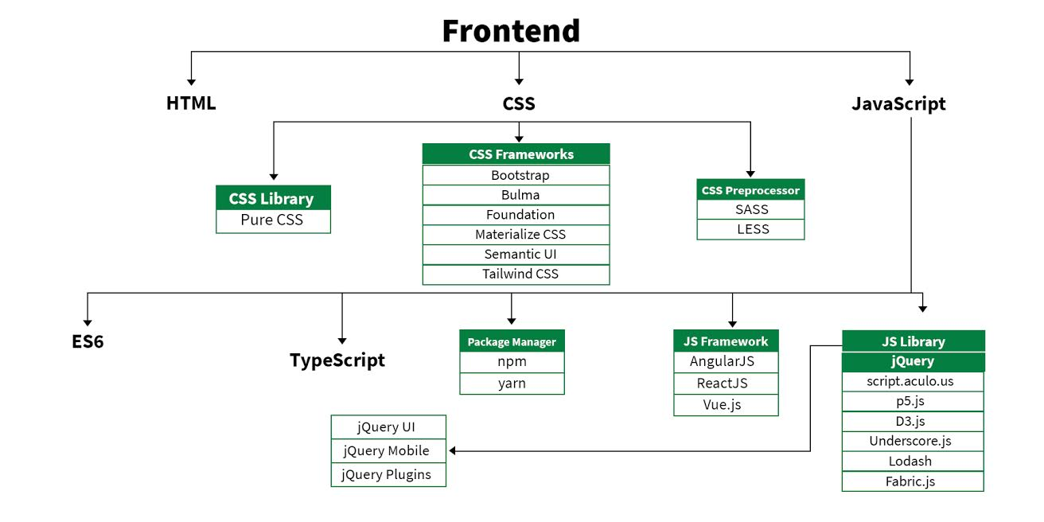
Frontend

Slide 9
Methodology
This Language Translator Web application helps us to translate Words/Sentences from English to any other language and vice versa.
The following is the Methodology that it follows:
The user has to first enter the Text in the text box, whether it be word or sentence.
The language of the Text is then auto detected, i.e. if the language of the text is English then it is detected accordingly.
The user then has to select the language he/she wants to translate the text into by clicking the dropdown menu option.
The user then Clicks the Translate button below the text box.
Hence it results into the Translation of the Text entered by the user into the language selected by the user.

Slide 10
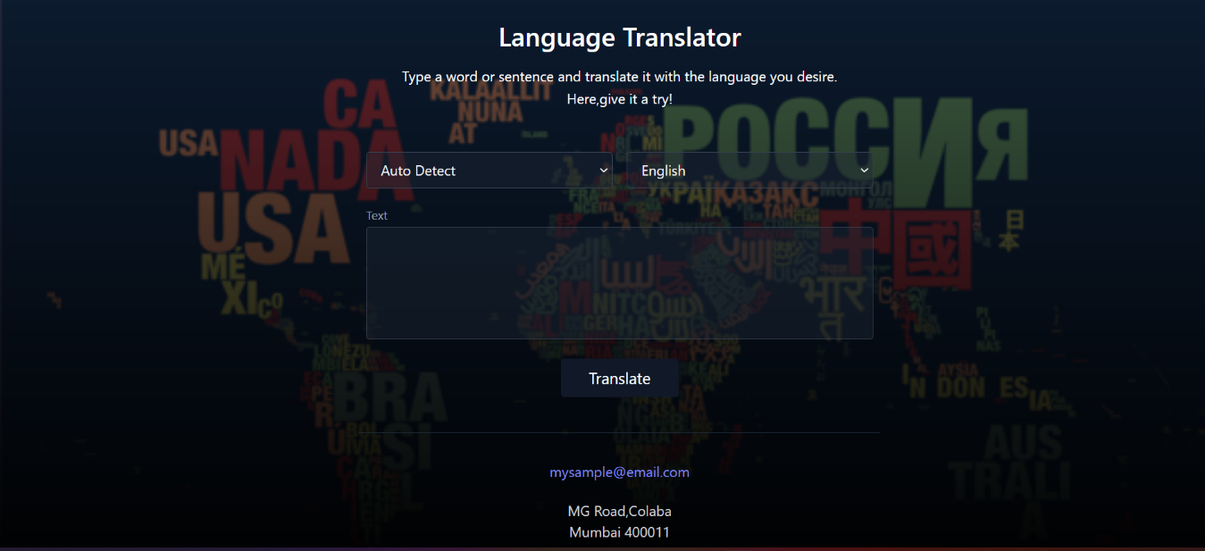
Web Application page:

Slide 11
Implementation
The following are the Software used in the project implementation:
• IDE- Visual Studio Code
• Front end Languages- HTML, CSS, JavaScript (Library-jQuery)
• Back end language- PHP

Slide 12
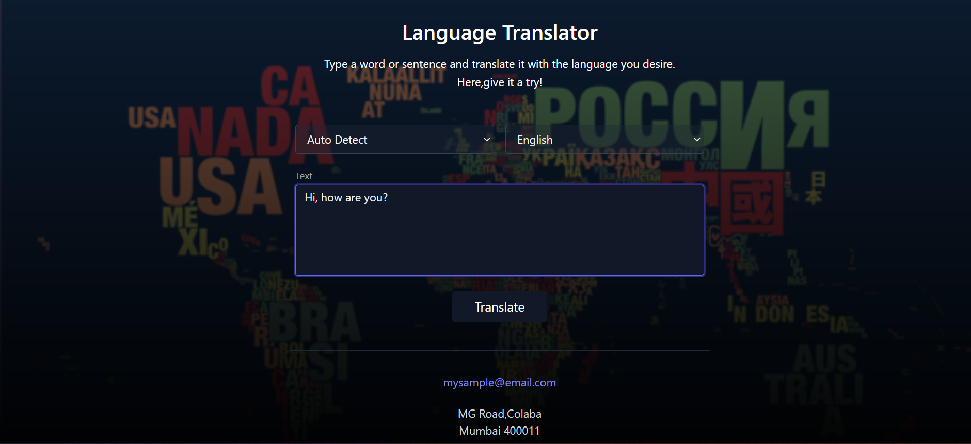
Input:

Slide 13
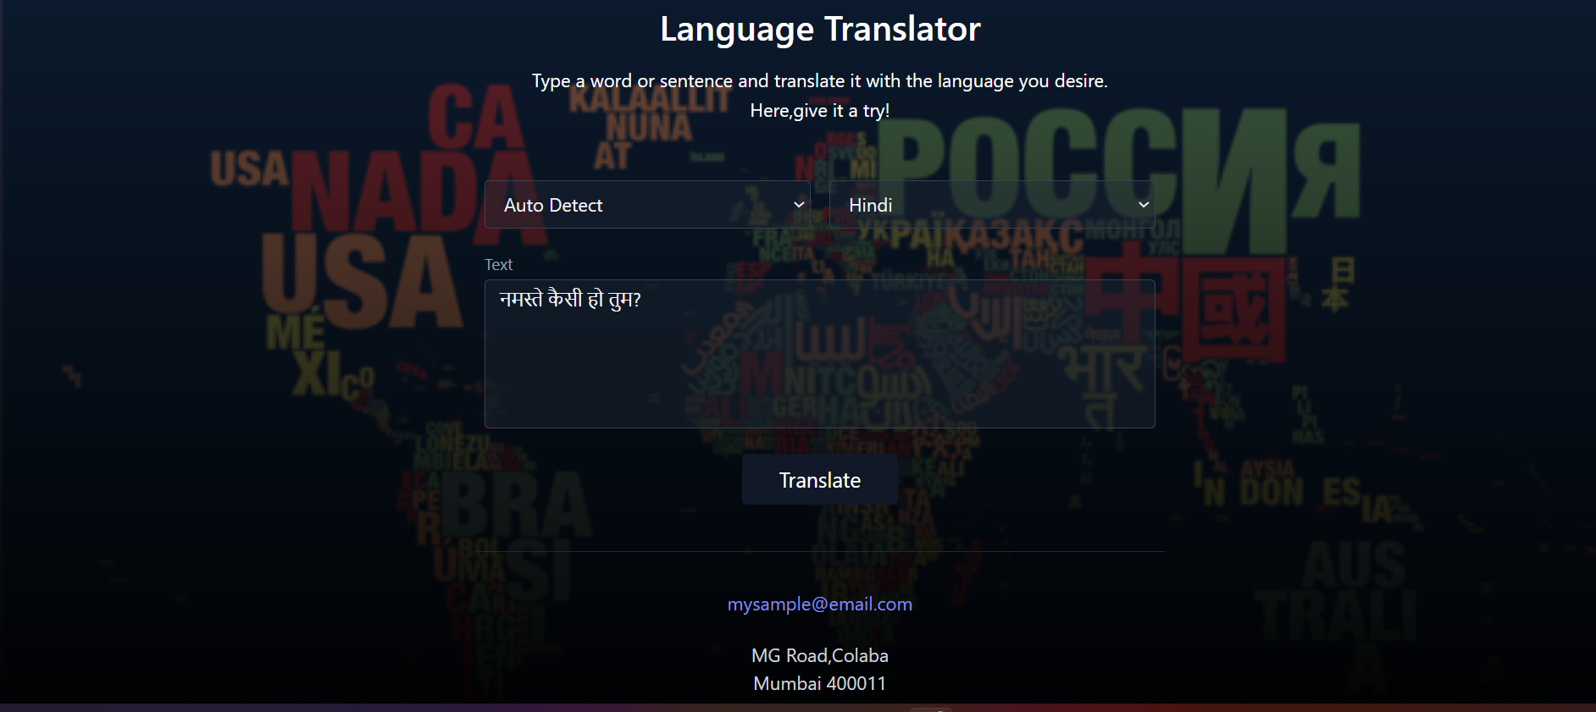
Output:

Slide 14
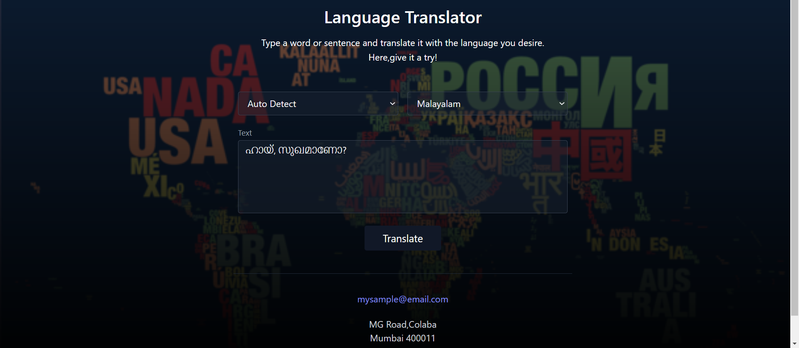
Output:

Slide 15

Output:

Slide 16
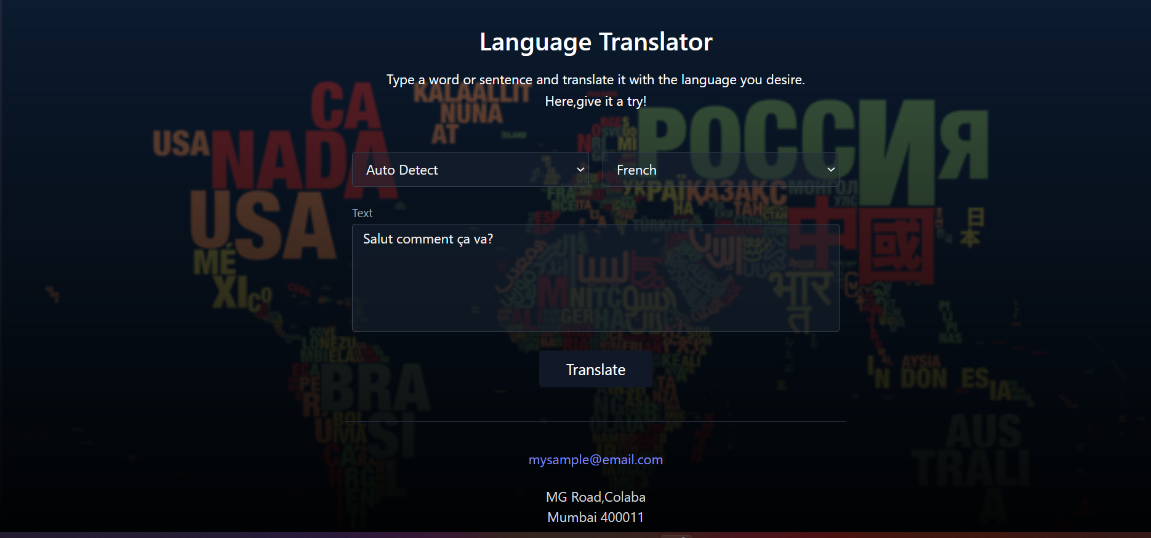
Output:

Slide 17
Conclusion
Human beings take about a year to learn a language but computers can learn in a day. With the help of this Language translator application people will be able communicate with each other with no Language barrier and can access the application through internet anywhere in the world.
So the project is successfully completed and can Translate any Language into English and vice versa. Hence it is feasible for the users to use and Translate words and Sentences into the language they wish.

Slide 18
Thank You!

